Slide 1
CSE 319 Software Engineering
Lecture : Dependability and Security Specification
Anisur Rahman
Military Institute of Science and Technology

Slide 2
Topics covered
Risk-driven specification
Safety specification
Security specification
Software reliability specification

Slide 3
Dependability requirements
Functional requirements to define error checking and recovery facilities and protection against system failures.
Non-functional requirements defining the required reliability and availability of the system.
Excluding requirements that define states and conditions that must not arise.

Slide 4
Risk-driven specification
Critical systems specification should be risk-driven.
This approach has been widely used in safety and security-critical systems.
The aim of the specification process should be to understand the risks (safety, security, etc.) faced by the system and to define requirements that reduce these risks.

Slide 5
Stages of risk-based analysis
Risk identification
Identify potential risks that may arise.
Risk analysis and classification
Assess the seriousness of each risk.
Risk decomposition
Decompose risks to discover their potential root causes.
Risk reduction assessment
Define how each risk must be taken into eliminated or reduced when the system is designed.

Slide 6
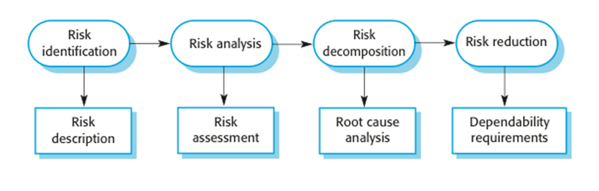
Risk-driven specification

Slide 7
Phased risk analysis
Preliminary risk analysis
Identifies risks from the systems environment. Aim is to develop an initial set of system security and dependability requirements.
Life cycle risk analysis
Identifies risks that emerge during design and development e.g. risks that are associated with the technologies used for system construction. Requirements are extended to protect against these risks.
Operational risk analysis
Risks associated with the system user interface and operator errors. Further protection requirements may be added to cope with these.

Slide 8
Safety specification
Goal is to identify protection requirements that ensure that system failures do not cause injury or death or environmental damage.
Risk identification = Hazard identification
Risk analysis = Hazard assessment
Risk decomposition = Hazard analysis
Risk reduction = safety requirements specification

Slide 9
Hazard identification
Identify the hazards that may threaten the system.
Hazard identification may be based on different types of hazard:
Physical hazards
Electrical hazards
Biological hazards
Service failure hazards
Etc.

Slide 10
Insulin pump risks
Insulin overdose (service failure).
Insulin underdose (service failure).
Power failure due to exhausted battery (electrical).
Electrical interference with other medical equipment (electrical).
Poor sensor and actuator contact (physical).
Parts of machine break off in body (physical).
Infection caused by introduction of machine (biological).
Allergic reaction to materials or insulin (biological).

Slide 11
Hazard assessment
The process is concerned with understanding the likelihood that a risk will arise and the potential consequences if an accident or incident should occur.
Risks may be categorized as:
Intolerable. Must never arise or result in an accident
As low as reasonably practical(ALARP). Must minimise the possibility of risk given cost and schedule constraints
Acceptable. The consequences of the risk are acceptable and no extra costs should be incurred to reduce hazard probability

Slide 12
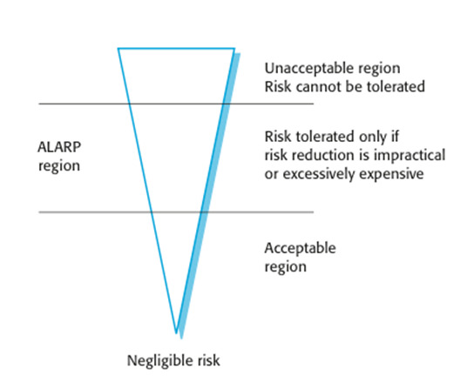
The risk triangle

Slide 13
Social acceptability of risk
The acceptability of a risk is determined by human, social and political considerations.
In most societies, the boundaries between the regions are pushed upwards with time i.e. society is less willing to accept risk
For example, the costs of cleaning up pollution may be less than the costs of preventing it but this may not be socially acceptable.
Risk assessment is subjective
Risks are identified as probable, unlikely, etc. This depends on who is making the assessment.

Slide 14
Hazard assessment
Estimate the risk probability and the risk severity.
It is not normally possible to do this precisely so relative values are used such as ‘unlikely’, ‘rare’, ‘very high’, etc.
The aim must be to exclude risks that are likely to arise or that have high severity.

Slide 15
Risk classification for the insulin pump
Identified hazard | Hazard probability | Accident severity | Estimated risk | Acceptability
1.Insulin overdose computation | Medium | High | High | Intolerable
2. Insulin underdose computation | Medium | Low | Low | Acceptable
3. Failure of hardware monitoring system | Medium | Medium | Low | ALARP
4. Power failure | High | Low | Low | Acceptable
5. Machine incorrectly fitted | High | High | High | Intolerable
6. Machine breaks in patient | Low | High | Medium | ALARP
7. Machine causes infection | Medium | Medium | Medium | ALARP
8. Electrical interference | Low | High | Medium | ALARP
9. Allergic reaction | Low | Low | Low | Acceptable

Slide 16
Hazard analysis
Concerned with discovering the root causes of risks in a particular system.
Techniques have been mostly derived from safety-critical systems and can be
Inductive, bottom-up techniques. Start with a proposed system failure and assess the hazards that could arise from that failure;
Deductive, top-down techniques. Start with a hazard and deduce what the causes of this could be.

Slide 17
Fault-tree analysis
A deductive top-down technique.
Put the risk or hazard at the root of the tree and identify the system states that could lead to that hazard.
Where appropriate, link these with ‘and’ or ‘or’ conditions.
A goal should be to minimise the number of single causes of system failure.

Slide 18
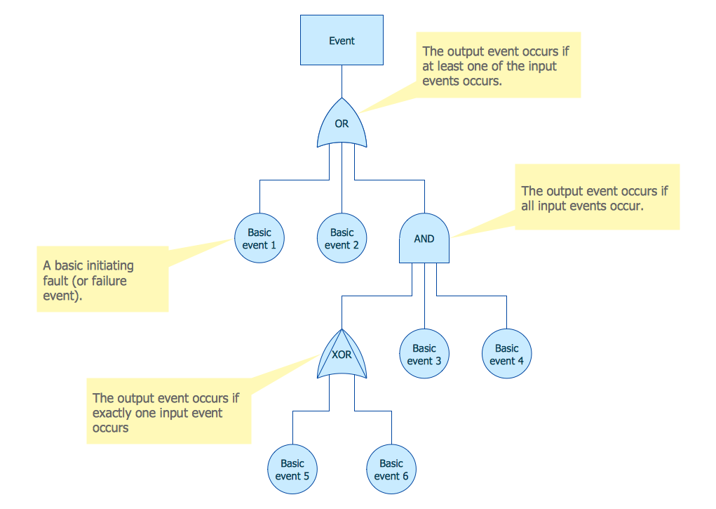
Symbols - software fault tree

Slide 19
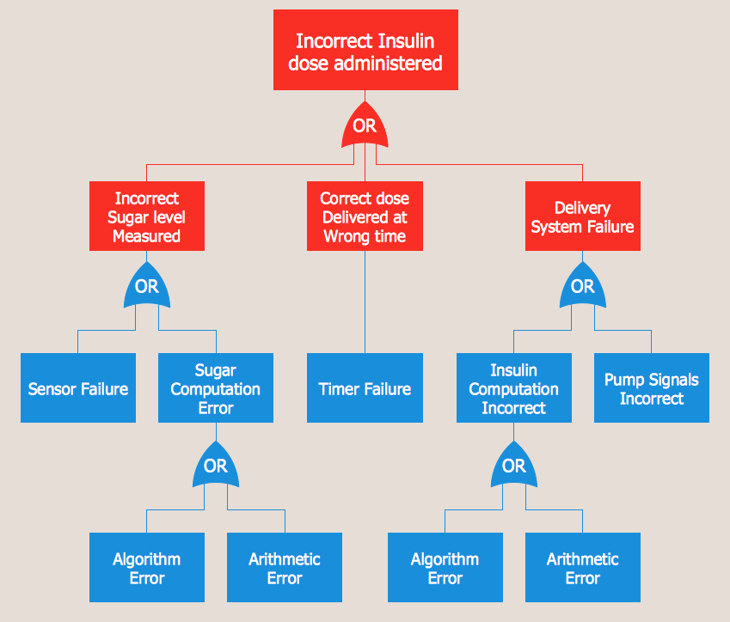
An example of a software fault tree

Slide 20
Fault tree analysis
Three possible conditions that can lead to delivery of incorrect dose of insulin
Incorrect measurement of blood sugar level
Failure of delivery system
Dose delivered at wrong time
By analysis of the fault tree, root causes of these hazards related to software are:
Algorithm error
Arithmetic error

Slide 21
Risk reduction
The aim of this process is to identify dependability requirements that specify how the risks should be managed and ensure that accidents/incidents do not arise.
Risk reduction strategies
Risk avoidance;
Risk detection and removal;
Damage limitation.

Slide 22
Strategy use
Normally, in critical systems, a mix of risk reduction strategies are used.
In a chemical plant control system, the system will include sensors to detect and correct excess pressure in the reactor.
However, it will also include an independent protection system that opens a relief valve if dangerously high pressure is detected.

Slide 23
Insulin pump - software risks
Arithmetic error
A computation causes the value of a variable to overflow or underflow;
Maybe include an exception handler for each type of arithmetic error.
Algorithmic error
Compare dose to be delivered with previous dose or safe maximum doses. Reduce dose if too high.

Slide 24
Examples of safety requirements
SR1: The system shall not deliver a single dose of insulin that is greater than a specified maximum dose for a system user.
SR2: The system shall not deliver a daily cumulative dose of insulin that is greater than a specified maximum daily dose for a system user.
SR3: The system shall include a hardware diagnostic facility that shall be executed at least four times per hour.
SR4: The system shall include an exception handler for all of the exceptions that are identified in Table 3.
SR5: The audible alarm shall be sounded when any hardware or software anomaly is discovered and a diagnostic message, as defined in Table 4, shall be displayed.
SR6: In the event of an alarm, insulin delivery shall be suspended until the user has reset the system and cleared the alarm.

Slide 25
Key points
Risk analysis is an important activity in the specification of security and dependability requirements. It involves identifying risks that can result in accidents or incidents.
A hazard-driven approach may be used to understand the safety requirements for a system. You identify potential hazards and decompose these (using methods such as fault tree analysis) to discover their root causes.
Safety requirements should be included to ensure that hazards and accidents do not arise or, if this is impossible, to limit the damage caused by system failure.

Slide 26
Chapter 12 – Dependability and Security Specification
Lecture 2

Slide 27
System reliability specification
Reliability is a measurable system attribute so non-functional reliability requirements may be specified quantitatively. These define the number of failures that are acceptable during normal use of the system or the time in which the system must be available.
Functional reliability requirements define system and software functions that avoid, detect or tolerate faults in the software and so ensure that these faults do not lead to system failure.
Software reliability requirements may also be included to cope with hardware failure or operator error.

Slide 28
Reliability specification process
Risk identification
Identify the types of system failure that may lead to economic losses.
Risk analysis
Estimate the costs and consequences of the different types of software failure.
Risk decomposition
Identify the root causes of system failure.
Risk reduction
Generate reliability specifications, including quantitative requirements defining the acceptable levels of failure.

Slide 29
Types of system failure
Failure type | Description
Loss of service | The system is unavailable and cannot deliver its services to users. You may separate this into loss of critical services and loss of non-critical services, where the consequences of a failure in non-critical services are less than the consequences of critical service failure.
Incorrect service delivery | The system does not deliver a service correctly to users. Again, this may be specified in terms of minor and major errors or errors in the delivery of critical and non-critical services.
System/data corruption | The failure of the system causes damage to the system itself or its data. This will usually but not necessarily be in conjunction with other types of failures.

Slide 30
Reliability metrics
Reliability metrics are units of measurement of system reliability.
System reliability is measured by counting the number of operational failures and, where appropriate, relating these to the demands made on the system and the time that the system has been operational.
A long-term measurement programme is required to assess the reliability of critical systems.
Metrics
Probability of failure on demand
Rate of occurrence of failures/Mean time to failure
Availability

Slide 31
Probability of failure on demand (POFOD)
This is the probability that the system will fail when a service request is made. Useful when demands for service are intermittent and relatively infrequent.
Appropriate for protection systems where services are demanded occasionally and where there are serious consequence if the service is not delivered.
Relevant for many safety-critical systems with exception management components
Emergency shutdown system in a chemical plant.

Slide 32
Rate of fault occurrence (ROCOF)
Reflects the rate of occurrence of failure in the system.
ROCOF of 0.002 means 2 failures are likely in each 1000 operational time units e.g. 2 failures per 1000 hours of operation.
Relevant for systems where the system has to process a large number of similar requests in a short time
Credit card processing system, airline booking system.
Reciprocal of ROCOF is Mean time to Failure (MTTF)
Relevant for systems with long transactions i.e. where system processing takes a long time (e.g. CAD systems). MTTF should be longer than expected transaction length.

Slide 33
Availability
Measure of the fraction of the time that the system is available for use.
Takes repair and restart time into account
Availability of 0.998 means software is available for 998 out of 1000 time units.
Relevant for non-stop, continuously running systems
telephone switching systems, railway signalling systems.

Slide 34
Availability specification
Availability | Explanation
0.9 | The system is available for 90% of the time. This means that, in a 24-hour period (1,440 minutes), the system will be unavailable for 144 minutes.
0.99 | In a 24-hour period, the system is unavailable for 14.4 minutes.
0.999 | The system is unavailable for 84 seconds in a 24-hour period.
0.9999 | The system is unavailable for 8.4 seconds in a 24-hour period. Roughly, one minute per week.

Slide 35
Failure consequences
When specifying reliability, it is not just the number of system failures that matter but the consequences of these failures.
Failures that have serious consequences are clearly more damaging than those where repair and recovery is straightforward.
In some cases, therefore, different reliability specifications for different types of failure may be defined.

Slide 36
Over-specification of reliability
Over-specification of reliability is a situation where a high-level of reliability is specified but it is not cost-effective to achieve this.
In many cases, it is cheaper to accept and deal with failures rather than avoid them occurring.
To avoid over-specification
Specify reliability requirements for different types of failure. Minor failures may be acceptable.
Specify requirements for different services separately. Critical services should have the highest reliability requirements.
Decide whether or not high reliability is really required or if dependability goals can be achieved in some other way.

Slide 37
Steps to a reliability specification
For each sub-system, analyse the consequences of possible system failures.
From the system failure analysis, partition failures into appropriate classes.
For each failure class identified, set out the reliability using an appropriate metric. Different metrics may be used for different reliability requirements.
Identify functional reliability requirements to reduce the chances of critical failures.

Slide 38
Insulin pump specification
Probability of failure (POFOD) is the most appropriate metric.
Transient failures that can be repaired by user actions such as recalibration of the machine. A relatively low value of POFOD is acceptable (say 0.002) – one failure may occur in every 500 demands.
Permanent failures require the software to be re-installed by the manufacturer. This should occur no more than once per year. POFOD for this situation should be less than 0.00002.

Slide 39
Functional reliability requirements
Checking requirements that identify checks to ensure that incorrect data is detected before it leads to a failure.
Recovery requirements that are geared to help the system recover after a failure has occurred.
Redundancy requirements that specify redundant features of the system to be included.
Process requirements for reliability which specify the development process to be used may also be included.

Slide 40
Examples of functional reliability requirements for MHC-PMS
RR1: A pre-defined range for all operator inputs shall be defined and the system shall check that all operator inputs fall within this pre-defined range. (Checking)
RR2: Copies of the patient database shall be maintained on two separate servers that are not housed in the same building. (Recovery, redundancy)
RR3: N-version programming shall be used to implement the braking control system. (Redundancy)
RR4: The system must be implemented in a safe subset of Ada and checked using static analysis. (Process)

Slide 41
Security specification
Security specification has something in common with safety requirements specification – in both cases, your concern is to avoid something bad happening.
Four major differences
Safety problems are accidental – the software is not operating in a hostile environment. In security, you must assume that attackers have knowledge of system weaknesses
When safety failures occur, you can look for the root cause or weakness that led to the failure. When failure results from a deliberate attack, the attacker may conceal the cause of the failure.
Shutting down a system can avoid a safety-related failure. Causing a shut down may be the aim of an attack.
Safety-related events are not generated from an intelligent adversary. An attacker can probe defenses over time to discover weaknesses.

Slide 42
Types of security requirement
Identification requirements.
Authentication requirements.
Authorization requirements.
Immunity requirements.
Integrity requirements.
Intrusion detection requirements.
Non-repudiation requirements.
Privacy requirements.
Security auditing requirements.
System maintenance security requirements.

Slide 43
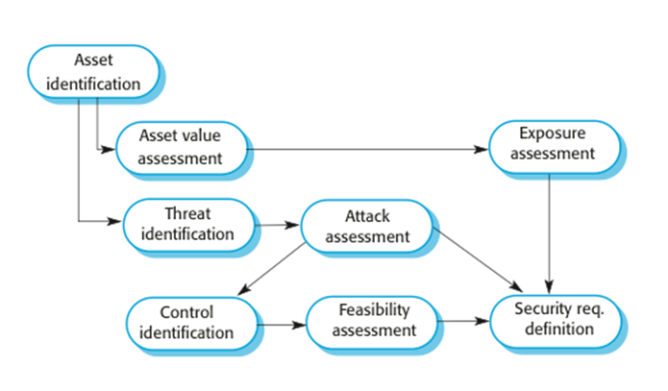
The preliminary risk assessment process for security requirements

Slide 44
Security risk assessment
Asset identification
Identify the key system assets (or services) that have to be protected.
Asset value assessment
Estimate the value of the identified assets.
Exposure assessment
Assess the potential losses associated with each asset.
Threat identification
Identify the most probable threats to the system assets

Slide 45
Security risk assessment
Attack assessment
Decompose threats into possible attacks on the system and the ways that these may occur.
Control identification
Propose the controls that may be put in place to protect an asset.
Feasibility assessment
Assess the technical feasibility and cost of the controls.
Security requirements definition
Define system security requirements. These can be infrastructure or application system requirements.

Slide 46
Asset analysis in a preliminary risk assessment report for the MHC-PMS
Asset | Value | Exposure
The information system | High. Required to support all clinical consultations. Potentially safety-critical. | High. Financial loss as clinics may have to be canceled. Costs of restoring system. Possible patient harm if treatment cannot be prescribed.
The patient database | High. Required to support all clinical consultations. Potentially safety-critical. | High. Financial loss as clinics may have to be canceled. Costs of restoring system. Possible patient harm if treatment cannot be prescribed.
An individual patient record | Normally low although may be high for specific high-profile patients. | Low direct losses but possible loss of reputation.

Slide 47
Threat and control analysis in a preliminary risk assessment report
Threat | Probability | Control | Feasibility
Unauthorized user gains access as system manager and makes system unavailable | Low | Only allow system management from specific locations that are physically secure. | Low cost of implementation but care must be taken with key distribution and to ensure that keys are available in the event of an emergency.
Unauthorized user gains access as system user and accesses confidential information | High | Require all users to authenticate themselves using a biometric mechanism. Log all changes to patient information to track system usage. | Technically feasible but high-cost solution. Possible user resistance. Simple and transparent to implement and also supports recovery.

Slide 48
Security policy
An organizational security policy applies to all systems and sets out what should and should not be allowed.
For example, a military policy might be:
Readers may only examine documents whose classification is the same as or below the readers vetting level.
A security policy sets out the conditions that must be maintained by a security system and so helps identify system security requirements.

Slide 49
Security requirements for the MHC-PMS
Patient information shall be downloaded at the start of a clinic session to a secure area on the system client that is used by clinical staff.
All patient information on the system client shall be encrypted.
Patient information shall be uploaded to the database after a clinic session has finished and deleted from the client computer.
A log on a separate computer from the database server must be maintained of all changes made to the system database.

Slide 50
Formal specification
Formal specification is part of a more general collection of techniques that are known as ‘formal methods’.
These are all based on mathematical representation and analysis of software.
Formal methods include
Formal specification;
Specification analysis and proof;
Transformational development;
Program verification.

Slide 51
Use of formal methods
The principal benefits of formal methods are in reducing the number of faults in systems.
Consequently, their main area of applicability is in critical systems engineering. There have been several successful projects where formal methods have been used in this area.
In this area, the use of formal methods is most likely to be cost-effective because high system failure costs must be avoided.

Slide 52
Specification in the software process
Specification and design are inextricably intermingled.
Architectural design is essential to structure a specification and the specification process.
Formal specifications are expressed in a mathematical notation with precisely defined vocabulary, syntax and semantics.

Slide 53
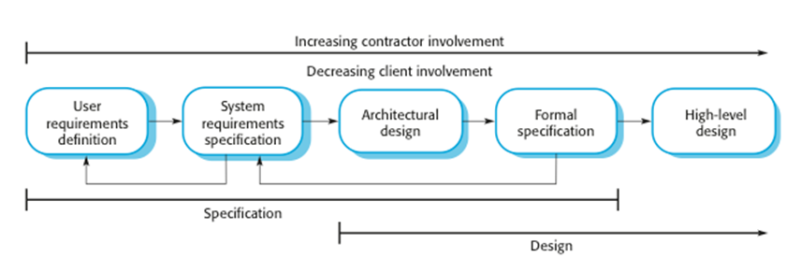
Formal specification in a plan-based software process

Slide 54
Benefits of formal specification
Developing a formal specification requires the system requirements to be analyzed in detail. This helps to detect problems, inconsistencies and incompleteness in the requirements.
As the specification is expressed in a formal language, it can be automatically analyzed to discover inconsistencies and incompleteness.
If you use a formal method such as the B method, you can transform the formal specification into a ‘correct’ program.
Program testing costs may be reduced if the program is formally verified against its specification.

Slide 55
Acceptance of formal methods
Formal methods have had limited impact on practical software development:
Problem owners cannot understand a formal specification and so cannot assess if it is an accurate representation of their requirements.
It is easy to assess the costs of developing a formal specification but harder to assess the benefits. Managers may therefore be unwilling to invest in formal methods.
Software engineers are unfamiliar with this approach and are therefore reluctant to propose the use of FM.
Formal methods are still hard to scale up to large systems.
Formal specification is not really compatible with agile development methods.

Slide 56
Key points
Reliability requirements can be defined quantitatively. They include probability of failure on demand (POFOD), rate of occurrence of failure (ROCOF) and availability (AVAIL).
Security requirements are more difficult to identify than safety requirements because a system attacker can use knowledge of system vulnerabilities to plan a system attack, and can learn about vulnerabilities from unsuccessful attacks.
To specify security requirements, you should identify the assets that are to be protected and define how security techniques and technology should be used to protect these assets.
Formal methods of software development rely on a system specification that is expressed as a mathematical model. The use of formal methods avoids ambiguity in a critical systems specification.

